Slide 2

An introduction to Transport Stream & PSI / SI Tables
Rilskiy Igor
Nov.2008, Aug.2013

Slide 3
What will we cover
DVB and MPEG – what they mean.
SI and PSI data and its relevance
How stream packets are built up.
Forward Error Correction (FEC)
Conditional Access Elements

Slide 4

What is MPEG and what is DVB?
These two are sometimes confused.
MPEG is the standard for video and audio compression. It describes how the data is stored and how the receiver or DVD player can recover it.
DVB is a worldwide standard to allow multiple MPEG services to be carried. This allows receivers from different manufacturers to handle data streams in a predictable and consistent manner.

Slide 5
Video Compression Standards
There are 2 family of standards: ISO / IEC MPEG and ITU-T.
International Standardization Organization(ISO),
International Electrotechnical Commission (IEC),
MPEG (Moving Pictures Experts Group) produced the following MPEG standards:
MPEG-2, 1994 : video standards for television and telecommunications standards
MPEG-4, 1999 : advanced video coding standards
MPEG-7, 2001 : metadata for audio-video streams, Multimedia Content Description Interface
International Telecommunication Union (ITU-T) developed several recommendations for video coding:
H.264, 2002 : Advanced Video Codec (AVC), in conjunction with MPEG-4

Slide 6
DVB / ATSC / ISDB Core Standards
ISO/IEC 13818-1 (stream structure, basic tables):
Transport Stream and PES syntax;
PSI definition (PAT, PMT, CAT, NIT);
Definition of PCRs, PTS and DTS;
ISO/IEC 13818-2 (video codec description)
ISO/IEC 13818-3 (audio coding, MPEG 2 Part 3 or .mp3)
ISO/IEC 13818-7 (advanced audio coding - AAC)

Slide 7


Digital Broadcast Standards
SI definition, EPG assembling
DVB (Digital Video Broadcasting) - Europe
Satellite: DVB-S (ETS 300 421), DVB-S2
Cable: DVB-C (ETS 300 429), Euro-DOCSIS
Terrestrial: DVB-T (ETS 300 744, modulation COFDM), DVB-T2
Mobile: DVB-H
http://www.etsi.org/standards
ATSC (Advanced Television System Committee) - USA
Satellite: ATSC (A/65 Rev.C)
Cable: DOCSIS, IPTV, MOCA
Terrestrial: ATSC (modulation 8VSB)

Slide 8
Digital Broadcast Standards (continue)
ISDB (Integrated Services Digital Broadcasting) - Japan:
Satellite: ISDB-S (modulation PSK)
Cable: ISDB-C
Terrestrial: ISDB-T (modulation COFDM with PSK/QAM)
Mobile multimedia: ISDB-Tmm
DMB (Digital Multimedia Broadcasting) - South Korea:
Satellite: S-DMB (S-band used)
Terrestrial & Mobile: T-DMB

Slide 9

Program Stream
Primarily intended for storage and retrieval from storage media;
Grouping of video, audio, and data elementary streams that have a common time base;
Each program stream consists of only one program;
Uses in error free environments, so:
- Large packet size;
- Packets size may be variable (hard for decoder to predict start and end of packets);
DVD standard uses the MPEG-2 Program Stream

Slide 10
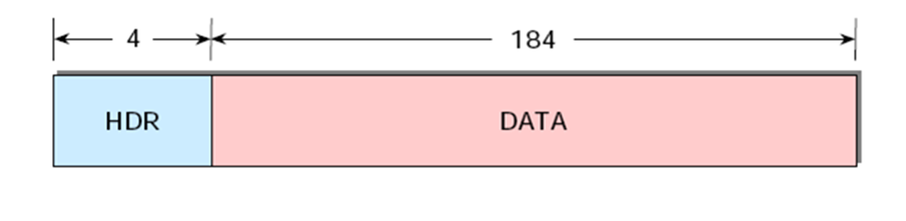
Transport Stream
Combines multiple programs into a single stream;
The programs may have or may not have common time base;
Transport Stream (TS) robust to interference/distortions due to:
- fixed length of packet;
- usage Forward Error Correction (FEC);
- f

Slide 11
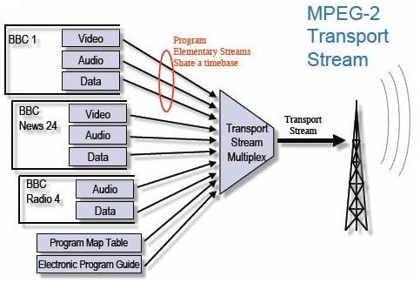
Transport Stream Multiplex

Slide 12
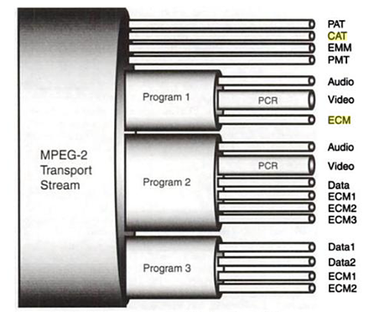
Transport Stream Model

Slide 13
Mission of PSI / SI / PSIP tables

Slide 14
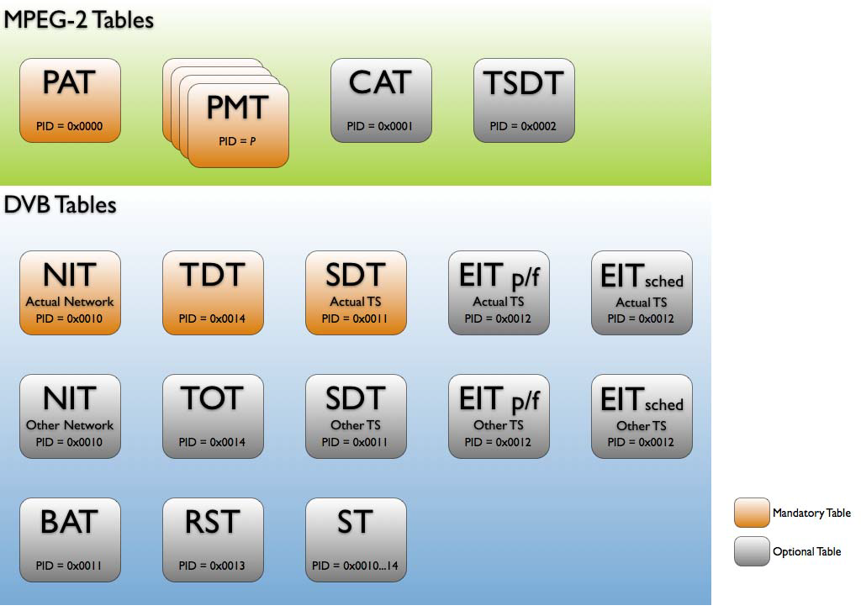
MPEG and DVB tables
PSI
SI

Slide 15

PSI data
PSI or Program Specific Information - the ISO/IEC13818 defined part.
Very basic data which tells the receiver which services are present and what the content is – video/audio etc.
Carries information on conditional access system.
PAT – Program Association Table
This is the first thing the box searches for and contains a list of the services and which PID contain the associated PMT.
PMT – Program Map Table
This expands on the PAT and tells the receiver what type of video/audio/data is carried (e.g. mpeg-2 or mpeg-4) and which PIDs they are on.
CAT – Conditional Access Table
This tells the receiver where to find the data required to decrypt the video and/or audio.

Slide 16

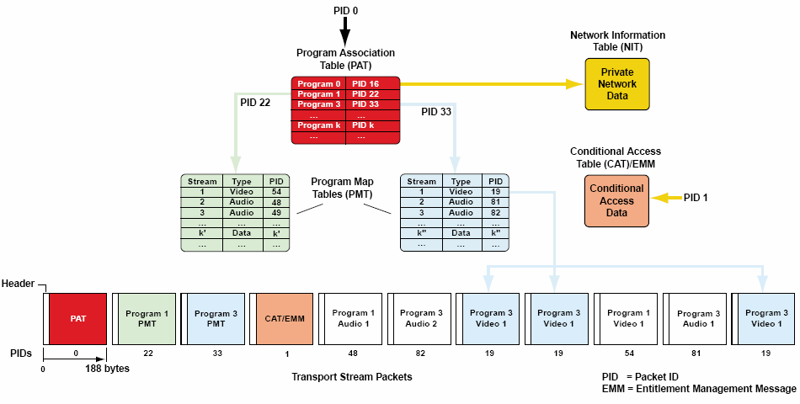
Interdependence PAT, PMT, NIT

Slide 17
DVB: SI data
NIT – Network Information Table.
NIT provides information about physical networks.
SDT – Service Description Table.
SDT contains data describing the services in the system e.g. names
of services, the service provider, etc.
EIT – Event Information Table. EIT contains data concerning events
or programmes such as event name, start time, duration, etc.
BAT – Bouquet Association Table
TDT – Time and Date Table.
TOT – Time Offset Table.
ST – Stuffing Table
RST – Running Status Table

Slide 18
ATSC: PSIP tables
PSIP is a Program and System Information Protocol
PSIP includes following main tables:
MGT – Master Guide Table.
MGT is directory of all PSIP tables.
VCT – Virtual Channel Table (List of the virtual channels).
STT – System Time Table.
RRT – Rating Region Table (Ratings definitions for the region).
EIT – Event Information Table. EIT contains data concerning events
or programmes such as event name, start time, duration, etc. for EPG.
ETT – Extended Text Table (Event descriptions for EPG).

Slide 19
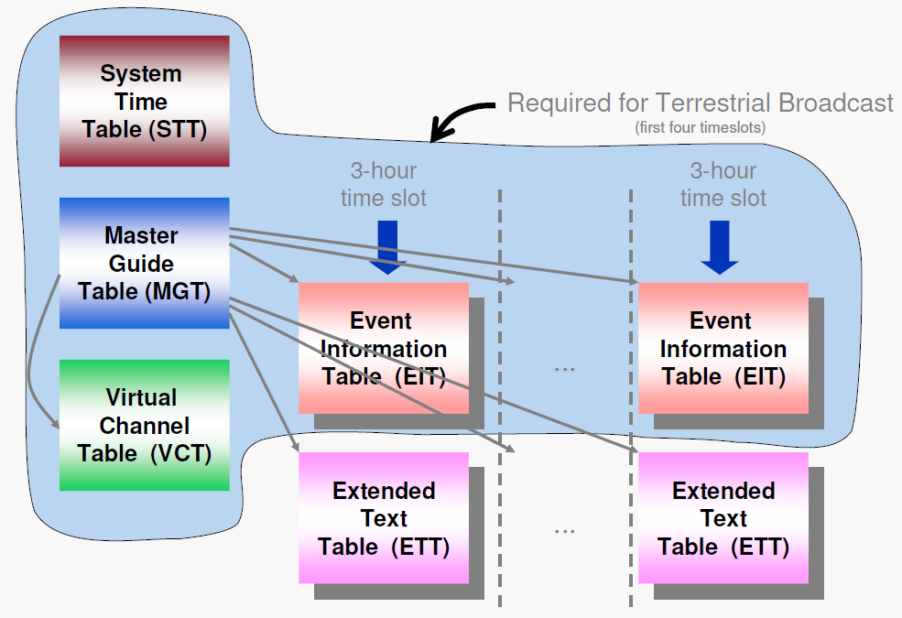
ATSC: PSIP tables

Slide 20
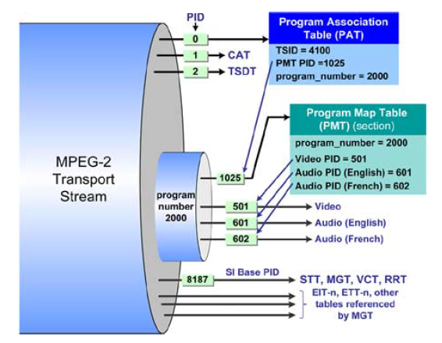
ATSC: Transport Stream and PSIP tables
MGT – Master Guide Table
VCT – Virtual Channel Table
STT – System Time Table.
RRT – Rating Region Table

Slide 21
Summary
network consists of one or more transport streams that are broadcast by the same provider;
transport stream is an MPEG-2/MPEG-4 stream containing several services;
each service is a TV channel, and consists of a series of events one after the other;
each event is a single TV show, and consists of a number of elementary streams;
each elementary stream is a packetized MPEG stream containing MPEG-2/MPEG-4 encoded audio, video or binary data;
several services (possibly from several different transport streams) can be grouped together logically in a bouquet;

Slide 22
Transport Stream Delivery

Slide 23

Transport Stream packet
The MPEG-2 TS is identified as a sequence of data packets, of fixed length (188 bytes, including header).

Slide 24
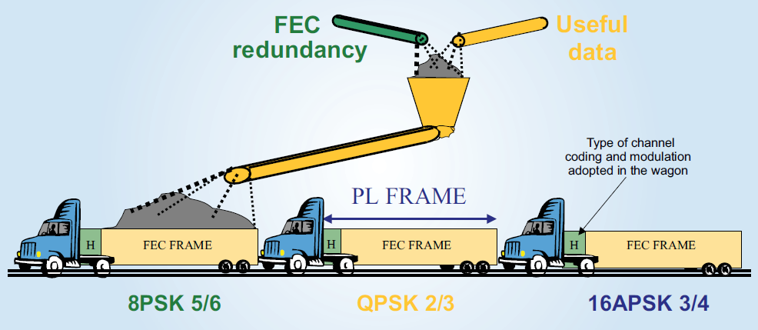
Forward Error Correction (FEC)
FEC (Forward Error Correction) is a method of obtaining error control in data communications in which the source sends redundant data in order to correct the errors arriving at the destination once they are detected. This reduces drastically the need for retransmissions.

Slide 25
Types of FEC
Algebraic or Block Coding;
Convolutional [сверточное] Coding (Sequential and Viterbi decoding);
Concatenated Coding, combines codification schemes, Block plus Convolutional;
Turbo Coding, one of the most efficient codes besides the LDPC coding.

Slide 26
FEC Rates
Among the most used:
Convolutional (Viterbi): 1/2, 2/3, 3/4, 5/6, 7/8
Reed-Solomon (RS): (204, 188) , (236, 216)
Turbo: 1/3, 2/5, 1/2, 2/3, 3/4, 5/6, 6/7, 7/8
LDPC: 1/4, 1/3, 2/5, 1/2, 3/5, 3/4, 5/6, 8/9, 9/10

Slide 27
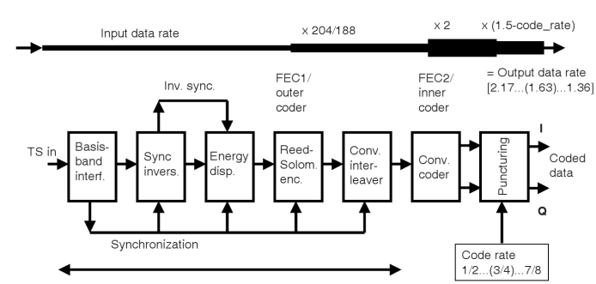
Forward Error Correction in DVB-C, DVB-T
same as DVB-C

Slide 28
Energy dispersal
With a technique called energy dispersal, the byte sequence is decorrelated.
This randomization ensures adequate binary transitions.
The process is accomplished with the Pseudo Random Binary Sequence (PRBS) generator.

Slide 29
DVB-S, DVB-T Forward Error Correction
Reed-Solomon coding
(204, 188)
Forney interleaving
Inner coding
(Viterbi)
only for DVB-S
38 Mbit/s
38 * 204/188 = 41,23 Mbit/s
A first level of protection for DVB-S and DVB-T is applied to the transmitted data, using a non-binary block code, a Reed-Solomon RS(204, 188) code, allowing the correlation of up to maximum of 8 wrong bytes for each 188-byte packet.
Inner interleaver splits stream into 2, 4, 6 streams (for QPSK, 16 or 64 QAM).
Interleaving block size is 126 bits, I = 12 for 2k system = 1512 bits.

Slide 30
DVB-S2, DVB-T2 Forward Error Correction
BCH
Encoder
LDPC
Encoder
Bit
interleaver
DVB-T2, DVB-S2 uses new Forward Error Correction codes:
(More powerful, less overhead)
– BCH (Bose-Chaudhuri-Hocquenghem) replaces Reed Solomon outer coding. BCH is multiple error correction binary block code.
– LDPC (Low Density Parity Check) replaces Viterbi inner coding;

Slide 31
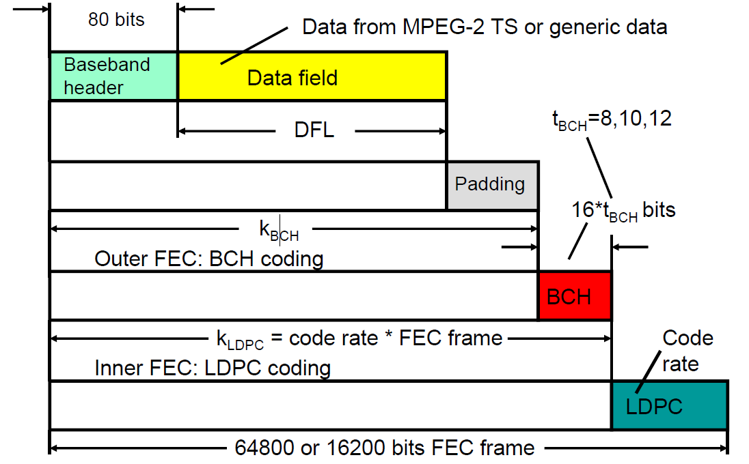
DVB-S2 FEC Frame

Slide 32
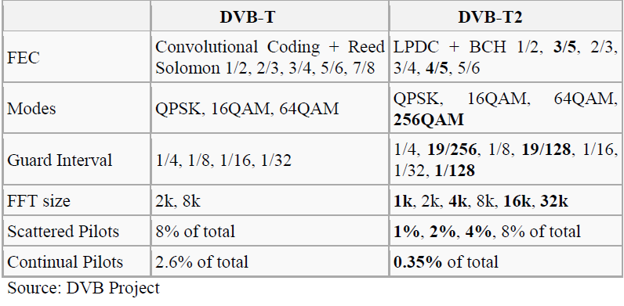
Comparison of available modes in DVB-T and DVB-T2

Slide 33
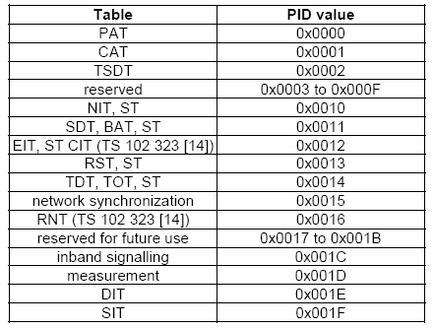
Packet Identifier (PID)
Each table or elementary stream in a transport stream is identified by a 13-bit PID. A demultiplexer extracts elementary streams from the transport stream in part by looking for packets identified by the same PID.
PID allocation (EN 300 468, p.18)

Slide 34
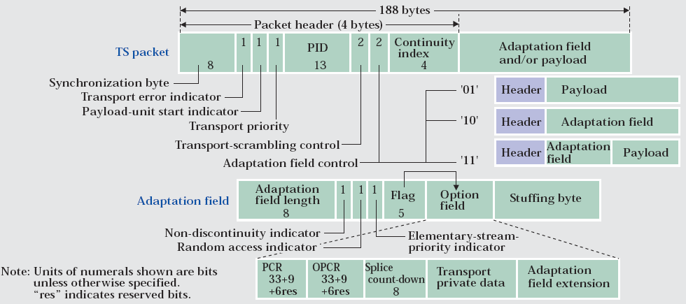
Transport Stream Packet Header

Slide 35
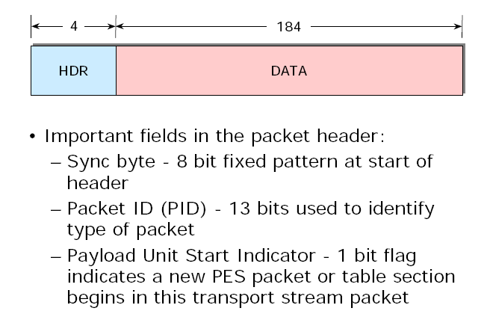
Transport Stream Packet

Slide 36
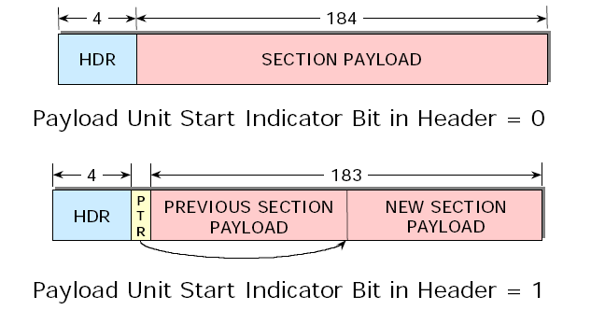
Payload Start Indicator & Section Assembling

Slide 37



Section Assembling
PSI=1
PSI=0
PSI=0
PSI=1
Sections may start at the beginning of the payload of a TS packet, but this is not a requirement, because the start of the first section in the payload of a TS packet is pointed to by the pointer_field.
There is never more than one pointer_field in a TS packet, as the start of any other section can be identified by counting the length of the first and any subsequent sections, since no gaps between sections within a TS packet are allowed by the syntax.

Slide 38
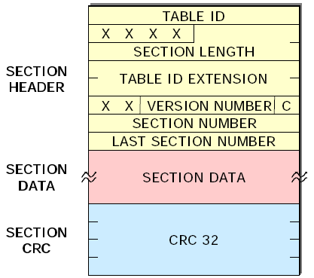
Common Section Format
The table_id identifies to which table the section belongs.
The table_id_extension is used for identification of a sub_table.
The section_number field allows the sections of a particular sub_table to be reassembled in their original order by the decoder. It is recommended, that sections are transmitted in numerical order, unless it is desired to transmit some sections of the sub_table more frequently than others, e.g. due to random access considerations.

Slide 39
Common Section Format
When the characteristics of the TS described in the SI given in the present document change (e.g. new events start, different composition of elementary streams for a given service), then new SI data shall be sent containing the updated information. A new version of the SI data is signalled by sending a sub_table with the same identifiers as the previous sub_table containing the relevant data, but with the next value of version_number.

Slide 40
Table_ID Values
Value | Description
0x01 | program_association_section
0x02 | conditional_access_section
0x03 | program_map_section
0x04 | transport_stream_description_section
0x40 | network_information_section – actual network
0x41 | network_information_section – other network
0x42 | service_description_section – actual transport stream
0x46 | service_description_section – other transport stream
0x4a | bouquet_association_section
0x4e | event_information_section – actual transport stream, present/forward
0x4f | event_information_section – other transport stream, present/forward
0x50…0x5f | event_information_section – actual transport stream, schedule
0x60…0x6f | event_information_section – other transport stream, schedule
0x70 | time_date_section

Slide 41
DVB: PSI / SI tables in depth

Slide 42
MPEG and DVB tables
PSI
SI

Slide 43
Interdependence PAT, PMT, NIT

Slide 44
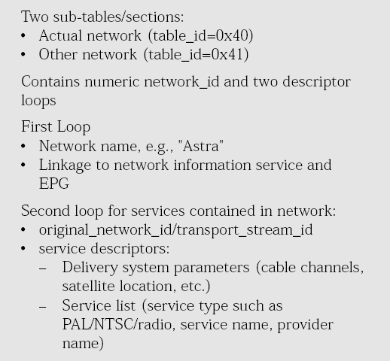
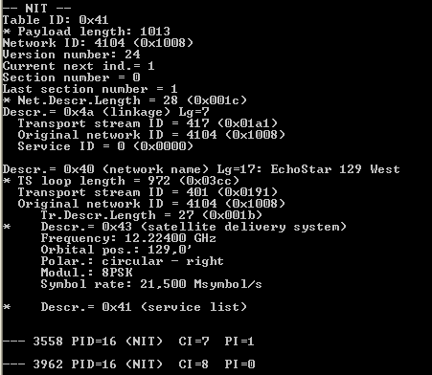
Network Information Table (NIT)
A “network” is the satellite or the country in the case of terrestrial. It is a unique 2 byte code, e.g. EchoStar 119W is 0x1004 and UK terrestrial is 0x233A

Slide 45
NIT hierarchy
NIT Table
Network ID 0x1004
Section 1 – Transport stream IDs 1 - 99
Section 2 – Transport stream IDs 1000 - 1199
Network ID 0x1006
Section 1 – Transport Stream IDs 200-299
Network ID 0x1009
Section 1 – Transport Stream IDs 300-399
Unique network ID assigned to each satellite slot, e.g. 119, even if multiple satellites are used to transmit the signals.

Slide 46
Building the transport stream list
NIT PID is hard coded, it is not acquired from the PAT;
Actual and other tables are processed at the same time;
First section received for each network ID initialises a bitmap to track how many sections are required;
Echostar's Transport Stream IDs are unique across networks;
STB can update it’s transponder scan tables in NVM;
STB does not use service list descriptor;
After a timeout period acquisition restarts with the NIT;

Slide 47
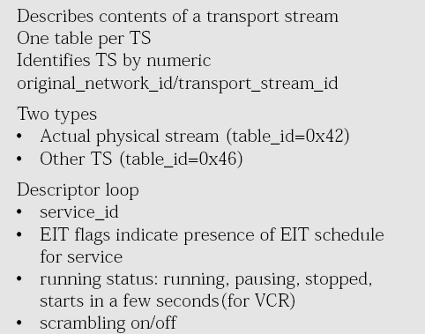
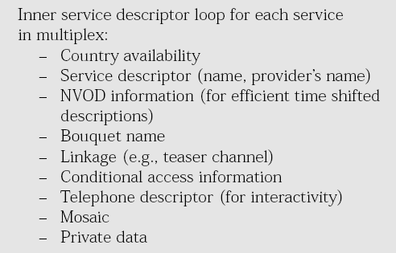
Service Description Table (SDT)

Slide 48
SDT hierarchy
SDT Table
Transport Stream ID 1
Section 1 Service 300
Transport Stream ID 2
Section 1 Service 101
Section 2 Service 200
Transport Stream ID 3
Section 1 Service 102

Slide 49
Building the channel list
Channel list based on the SDT information;
Actual and other tables are processed at the same time;
Each section’s header is checked against the saved NIT data to see if the transport stream is installed;
First section received for a transport stream ID initialises a bitmap to track how many sections are required;
After acquiring all sections for a transport stream the STB determines if sections for any additional transports are required;
After a timeout period acquisition restarts with the SDT;

Slide 50
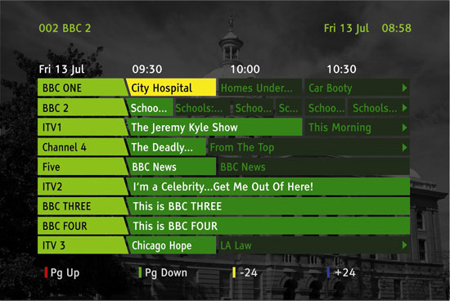
Electronic Program Guide (EPG) creation
EPG is a service for television, radio or other multimedia application displaying information about broadcasted content.
The user can browse through information on present or following program content or schedule from now up to some days ahead.

Slide 51
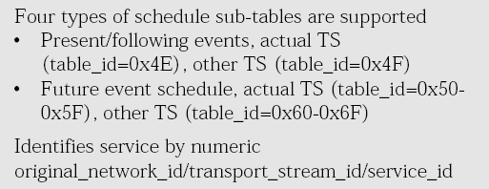
Event Information Table (EIT)
Basically there are two groups of EITs:
Present/following
Carrying information of events currently on-air (present) and events next on schedule (following). A typical repetition rate is 2 second.
Schedule
Carrying information of content from now up to some days ahead.

Slide 52
DVB triplet
DVB triplet is aggregate of :
original network ID (ONID);
transport stream ID (TSID);
service ID (SID).
DVB triplet is a unique identifier provided to the service provider.

Slide 53
EIT present / forward table
The present/following table shall contain only information relate to the present event and the chronologically following event carried by a given service on either the actual TS or another TS, except in the case of a Near Video On Demand (NVOD) reference service where it may have more than two event descriptions.
The EIT p/f table is optional. Its presence or absence shall be signalled by setting the EIT_present_following_flag in the SDT.

Slide 54
EIT p/f Hierarchy
EIT P/F Table
Transport Stream ID 1 Service ID 300
Section 0 - Present
Section 1 - Following
Transport Stream ID 2 Service ID 101
Section 0 Present
Section 1 Following
Transport Stream ID 2 Service 200
Section 0 Present
Section 1 Following

Slide 55
Building table with EIT present / forward
Needed prior to displaying A/V for parental controls
EIT p/f acquisition starts with the STB building the list of services for which EIT is required using the saved SDT data;
STB determines total number of sections it will acquire (2 per service);
Actual and other tables are processed at the same time;
EIT p/f version numbers are not checked;
Each section received is checked to see if it’s service ID and transport stream ID are needed, others are dropped;
Each section saved reduces count for how many additional sections are required. When count gets to zero, acquisition stops.

Slide 56
EIT schedule table
The event schedule tables for either the actual TS or other TSs, contain a list of events, in the form of a schedule including events other than the present and following events.
The EIT schedule tables are optional. Their presence or absence shall be signalled by setting the EIT_schedule_flag in the SDT. The event information shall be chronologically ordered.
The EIT shall be segmented into event_information_sections using the syntax of table 7.
Any sections forming part of an EIT shall be transmitted in TS packets with a PID value of 0x0012.

Slide 57
EIT schedule Hierarchy
EIT Schedule Table
Transport Stream ID 1 Service ID 300
Segment 0 , section 0 Events 1 - 10
Segment 1, Section 0 Events 10 - 20
Segment 2
Section 0 Events 30 – 35
Section 1 Events 35 - 40
Segment 3, section 0 Events 40 - 50
Transport Stream ID 2 Service ID 101
Segment 0, section 0 Events 1 - 10
Segment 1, section 0 Events 20 – 30
Segment 2, section 0 Events 30 - 40
Segment 3, section 0 Events 40 - 50

Slide 58
EIT schedule acquisition
Usually runs after completing initial acquire;
STB builds the list of services for which EIT is required using the saved SDT data;
STB determines total number of segments it will acquire (12 per service for 2-day guide);
Actual and other tables are processed at the same time;
First section header received is saved;
Each section received is checked to see if it’s service ID and transport stream ID are needed, others are dropped;
First section received for a service in a segment determines how many sections are required;
Each completed segment for a service reduces count for how many additional segments are required. When segments required count gets to zero, acquisition stops;
If EIT version number changes, acquired schedule data is dropped and acquisition is restarted;

Slide 59
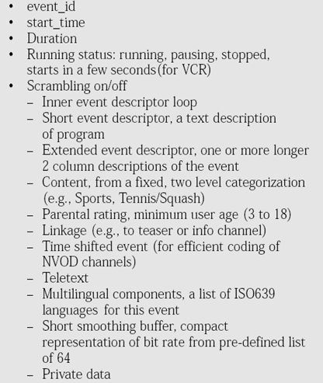
EIT content (descriptors)

Slide 60
ETSI TS 101 162 (ETR 162)
The present document identifies the codes allocated for SI, data broadcasting and MHP in DVB systems. The following
sets of code values are identified:
- the Original_Network_id used to identify the original network (DVB-SI);
- the Network_id used to identify a network (DVB-SI);
- the Bouquet_id used to identify a bouquet (DVB-SI);
- the CA_system_id used to identify the kind of encryption used (DVB-SI);
- the Country code used to identify a country or region (DVB-SI);
- the Private_data_specifier values used to identify a private SI system (DVB-SI);
- the Data_Broadcast_id used to identify a data broadcast specification (DVB-DATA);
- the Platform_id used to identify the IP/MAC platform in use (DVB-DATA);
- the CP_system_id used to identify the copy protection system (DVB-SI);
- the Encoding_type_id used to identify string encodings (DVB-SI);
These codes are allocated by the DVB Project at the request of potential service providers and once allocated, become part of EN 300 468 by reference.
(http://www.dvbservices.com)

Slide 61
Conditional Access Elements
Conditional Access Table (CAT);
Entitlement Management Message (EMM);
Entitlement Control Message (ECM);
The CAT shall contain one or more CA_descriptor, as defined in ISO/IEC 13818-1.
Already CAT PID = 1;
Each CA_descriptor provides the PID for EMMs for a particular conditional access system.
The EMM stream contains messages destined for a unique customer or group of customers. These messages, whose syntax and content are conditional access vendor specific, provide a variety administrative functions, such as authorization for those programs (aka services) to which end-user is entitled.
The EMM generally contains work key, necessary to decrypt an ECM carried in the ECM stream.
The EMM is ciphered using a Master Key.
CAT table acquisition requires to maintain smart card authorizations via EMMs.

Slide 62
Conditional Access Elements
The ECM consist CW (control word) for decrypt video/audio and content_id. ECM decrypt by means of work key.
Work key obtain from EMM by means of master key.

Slide 63
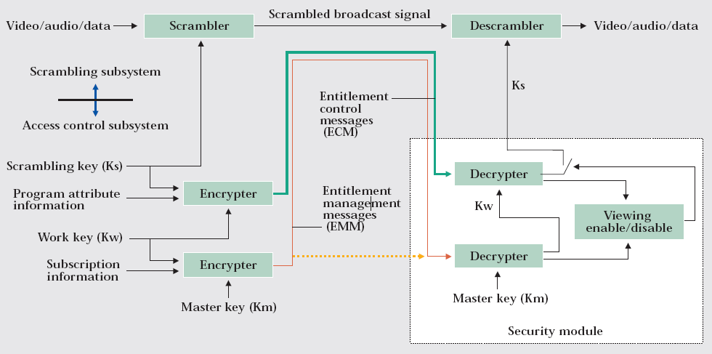
Configuration of a conditional access system

Slide 64
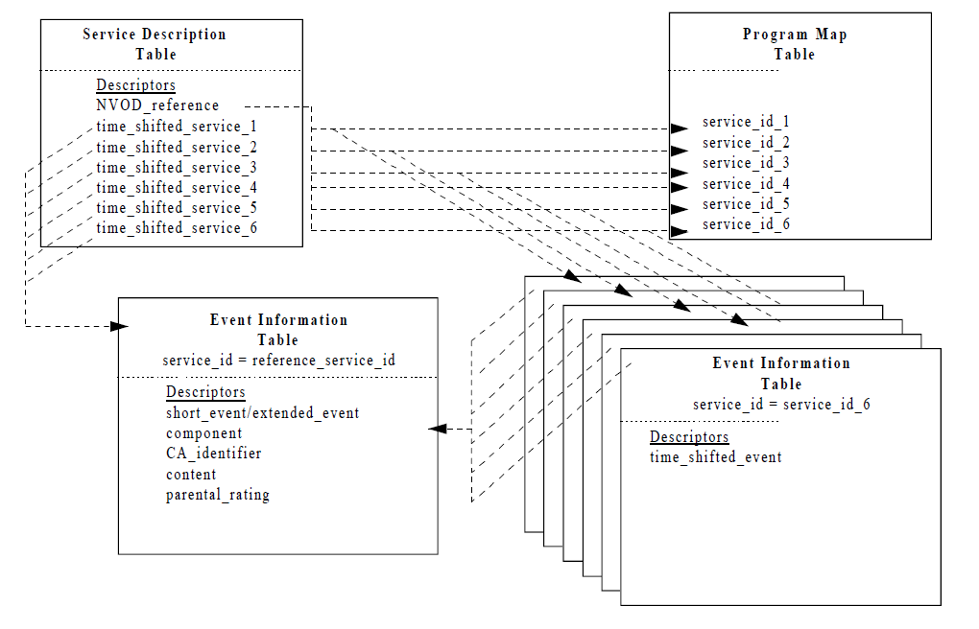
Near Video On Demand (NVOD) service
NVOD service means several time shifted versions of the same programme are transmitted simultaneously.
To describe such a NVOD service with conventional SI would require the repetition of six EITs. Instead the concept of a reference service is used.
The reference service is a fictitious service and provides a means within the SI of associating the actual time shifted services (services 1 to 6).
Notes:
This reference service is allocated a reference_service_id which links a common description of the events within the service for all the services belonging to the NVOD service. The EIT of the reference service can always be found in the TS in which the NVOD services are located. Each time shifted service is given a full reference in terms of transport_stream_id, original_network_id, service_id and these services are listed in the NVOD_reference_descriptor.
Using this method reduces the amount of data by nearly five times.

Slide 65
DVB Subtitles
Are carried in PES (themselves being carried in TS)
Timing of presentation is the PTS of the PES (present in the PES header)
Information is transmitted in graphical format
Pixel depths of 2, 4 and 8 bits are supported
Color information is organized in Color Look-Up Tables (CLUT)
Subtitles are present in a sequence of pages that are going to be overlayed on the associated video image
A subtitle page contains one or more regions (rectangular areas with specified sets of attributes: position, width, height, depth etc)
Several regions can be used at the same time (i.e. one region in the bottom of the screen displaying the subtitle, another in one somewhere else on the screen displaying some logo)
There are different events
page update (when only the changed regions from previous page are present)
page refresh (when all the data needed to display the page is present)

Slide 66

Questions

Slide 67


